Slide 1

From Idea to Open Source
Andrew Nagy

Slide 2
History
January 2006
  Build Homegrown Digital Library
October 2006
  Development of “MyResearch Portal” begins
February 2007
  Initial implementation ready and shown at Code4Lib 2007
July 2007
  Villanova University approves GPL license for code and releases VuFind into the open source community
January 2008
  VuFind shown at ALA Midwinter to a much broader audience
Spring 2008
  1.0 Release

Slide 3
Idea
Develop a web portal for library patrons to perform research activities:
  Search library catalog
  Search article databases
    And other local library catalogs
  Search digital library, etc.
Create 1 single interface for all library resources to minimize interface learning curve!

Slide 4
Hmmm…
Most academic libraries are dealing with the same problems
Let’s build a solution that will help many other libraries and that will attract other libraries to help collaborate on a common goal

Slide 5
Underlying Architecture
System needs to work with wide variety of ILSs
  We use Voyager (Most likely to switch to OSS)
  SirsiDynix
  III
  Aleph
Let’s not forget about our OSS cousins
  Koha
  Evergreen

Slide 6
Underlying Architecture
Keep the ILS doing what it does best
  Pull live Holdings data
  Harvest Bibliographic data
    or
  Query an existing index

Slide 7
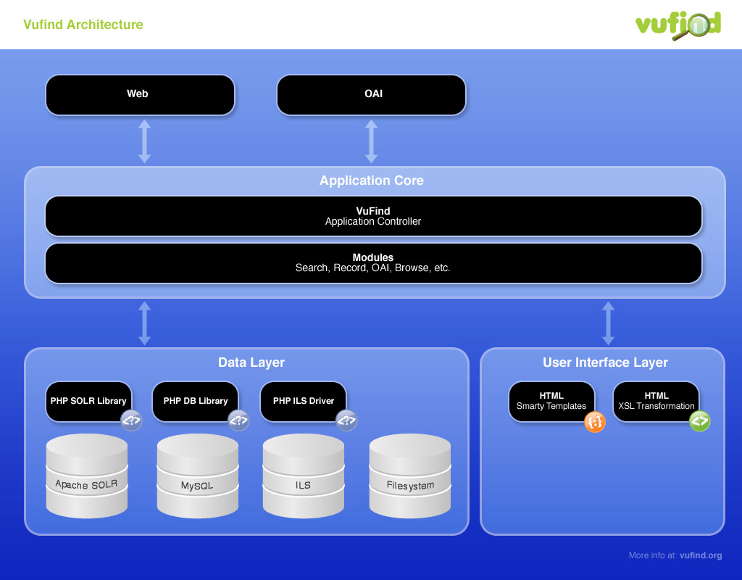

Slide 8
Underlying Architecture
Keep the ILS doing what it does best
  Pull live Holdings data
  Harvest Bibliographic data
    or
  Query an existing index
Needs to be able to be installed easily on a wide variety of platforms

Slide 9
Let’s Open Source
Build a collaborative community
  A small local team can build a solution
  A large diverse team can build a solution that is sustainable and feature rich
Villanova is not in the marketplace to sell/support software

Slide 10
Open Source Management
Choose the right tools for the community
SourceForge, Google Code, etc
  Limit granular control
Local SVN or CVS – True Freedom
  JIRA, TRAC, Bugzilla, etc.

Slide 11
Positives
Collaborative code sharing
Idea sharing
University gets national attention

Slide 12
Positives
Collaborative code sharing
Idea sharing
University gets national attention
Pay raise?

Slide 13
Negatives
Mailing list support
Time involved with marketing
Project switching is expensive
  This isn’t your only project

Slide 14
Lessons Learned

Slide 15
Market!
Open source software gets most attention from word of mouth
Seek out and form development partnerships early before it is too late

Slide 16
Adoption
Open source software becomes successful through adoption
Adoption requires
  Easy Install and Integration
  Strong User Interface
  Strong functionality

Slide 17
Agile Roadmap
Plan a roadmap for organization
  Your Institution vs Community
Keep the process agile
  Months or Quarters helps your users know when to plan for change or updates

